Slide 1



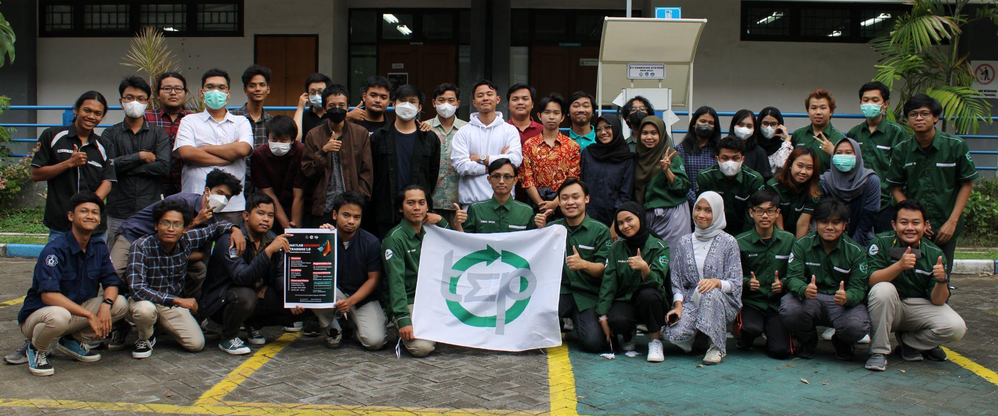
Control and Automation Laboratory
Kunjungan Kampus
SMK Taruna Bakti Kertosono
30 January 2023
AJ104 - Electrical Engineering Department ITS

Slide 2
SYSTEM
A collection of interrelated components that work together to achieve a specific goal
CONTROL
Efforts to maintain or achieve certain conditions in the physical system by changing certain variables
Measuring controlled system variables, applying manipulated variables, correcting deviations from the desired value
THEN, WHAT IS CONTROL SYSTEM?
Notes:
Control System :
A system in which the components have been configured to produce the desired system characteristics
Development of proper configuration of components to achieve performance object

Slide 3
Make sure every system working well
WHAT
WE
DO
Working with
smart system
Notes:
All industries or field that needed to be automated and or controlled by productions machine must need a Control Systems Engineer . Our jobs are to make sure every system works well (based on stability, contollability, and observability) .
Of course, due to the development of technology, we are working not only with big system but also with smaller and smart system like robots, cars, and many more.

Slide 4

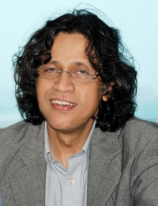
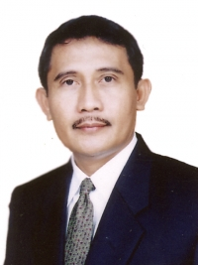
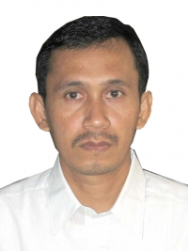
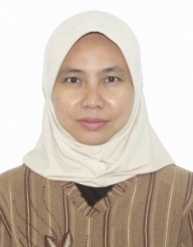
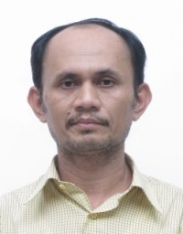
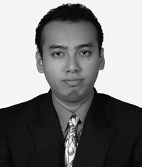

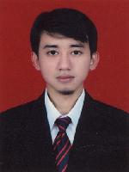
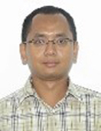
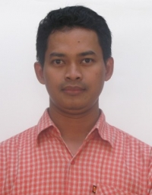

Abdullah Alkaff, Ir., MSc, Ph.D, Prof.
Achmad Jazidie, Ir., MEng, Dr., Prof.
Ari Santoso, Ir., DEA, Dr.
Trihastuti Agustinah, ST, MT, Dr.
Ali Fatoni, Ir., MT.
Eka Iskandar, ST, MT.
Yusuf Bilfaqih, ST, MT.
Nurlita Gamayanti, ST, MT.
Mohamad Abdul Hady, ST, MT.
Zulkifli Hidayat Nasution, ST, MSc.
Mochammad Sahal, ST, MSc.
LECTURERS

Slide 5
LABORATORY PROFILE
Name : Control and Automation Laboratory
Place : AJ 104 – AJ 103 and B105
Control and Automation Laboratory is one of the laboratories in the Electrical Engineering Department, in particular, the Control Systems Engineering. Activities in this laboratory are designed based on the Tri Dharma of Higher Education (Education, Research and Community Service)

Slide 6

AUTOMATION
Notes:
Automation : control processes which minimizes help from humans

Slide 7
LABORATORY MEMBERS
HEAD OF LABORATORY
Ari Santoso, Ir., DEA, Dr.
LABORATORIUM MEMBERS
Achmad Jazidie, Ir., MEng, Dr., Prof.
Mohamad Abdul Hady, ST, MT.
Ali Fatoni, Ir., MT.
Trihastuti Agustinah, ST, MT, Dr.
Eka Iskandar, ST, MT.

Slide 8
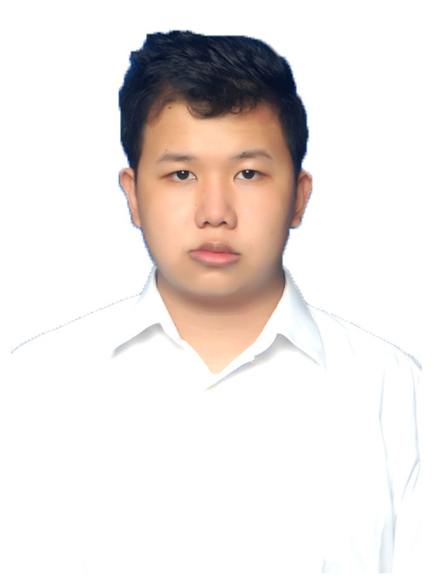
LABORATORY ASSISTANTS
Assistants Vice Coordinator : Yosia
Secretary and Treasurer : Inez, Ariel
Practicum Division Coordinator : Yanuar
Practicum Division : Soleh, Aqil N, Kian, Rayhan Haqi, Tealent Agung, Galih, Amsal, Andrey
Event Division Coordinator : Hanif R
Event Division : Nabilla, Agam, Nila, Ardi, Aqil R, Rafif, Hashfi, Himawan, Zahra, Daffa, Arik
Academic Division Coordinator : Faris
Academic Division : Cahyo, Doni, Alif, Trio, Rochim, Irfan, Lambang, Tiara, Rafy, Hakim
Media Division Coordinator : Putra
Media Division : Angga, Kivlan, Adam, Hanif F, Fariz, Maul
Vincentius Charles Maynad
Assistants Coordinator

Slide 9
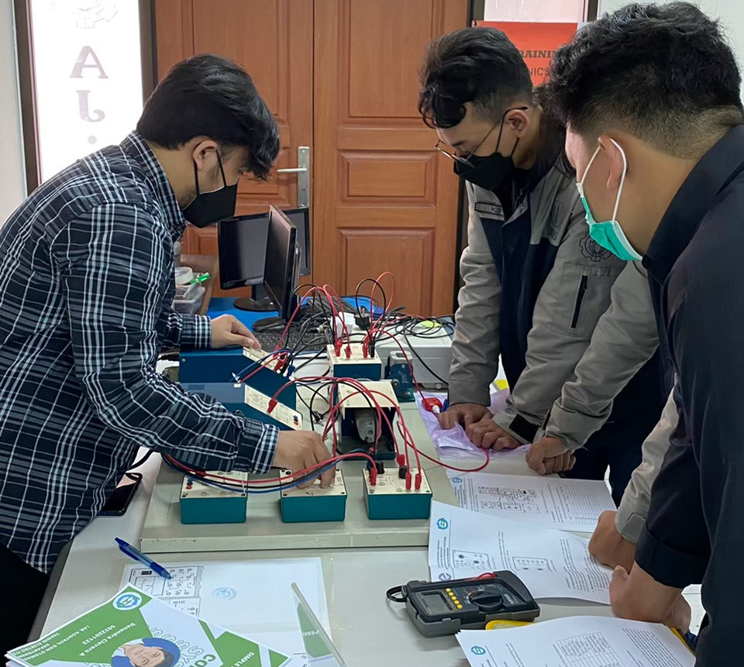
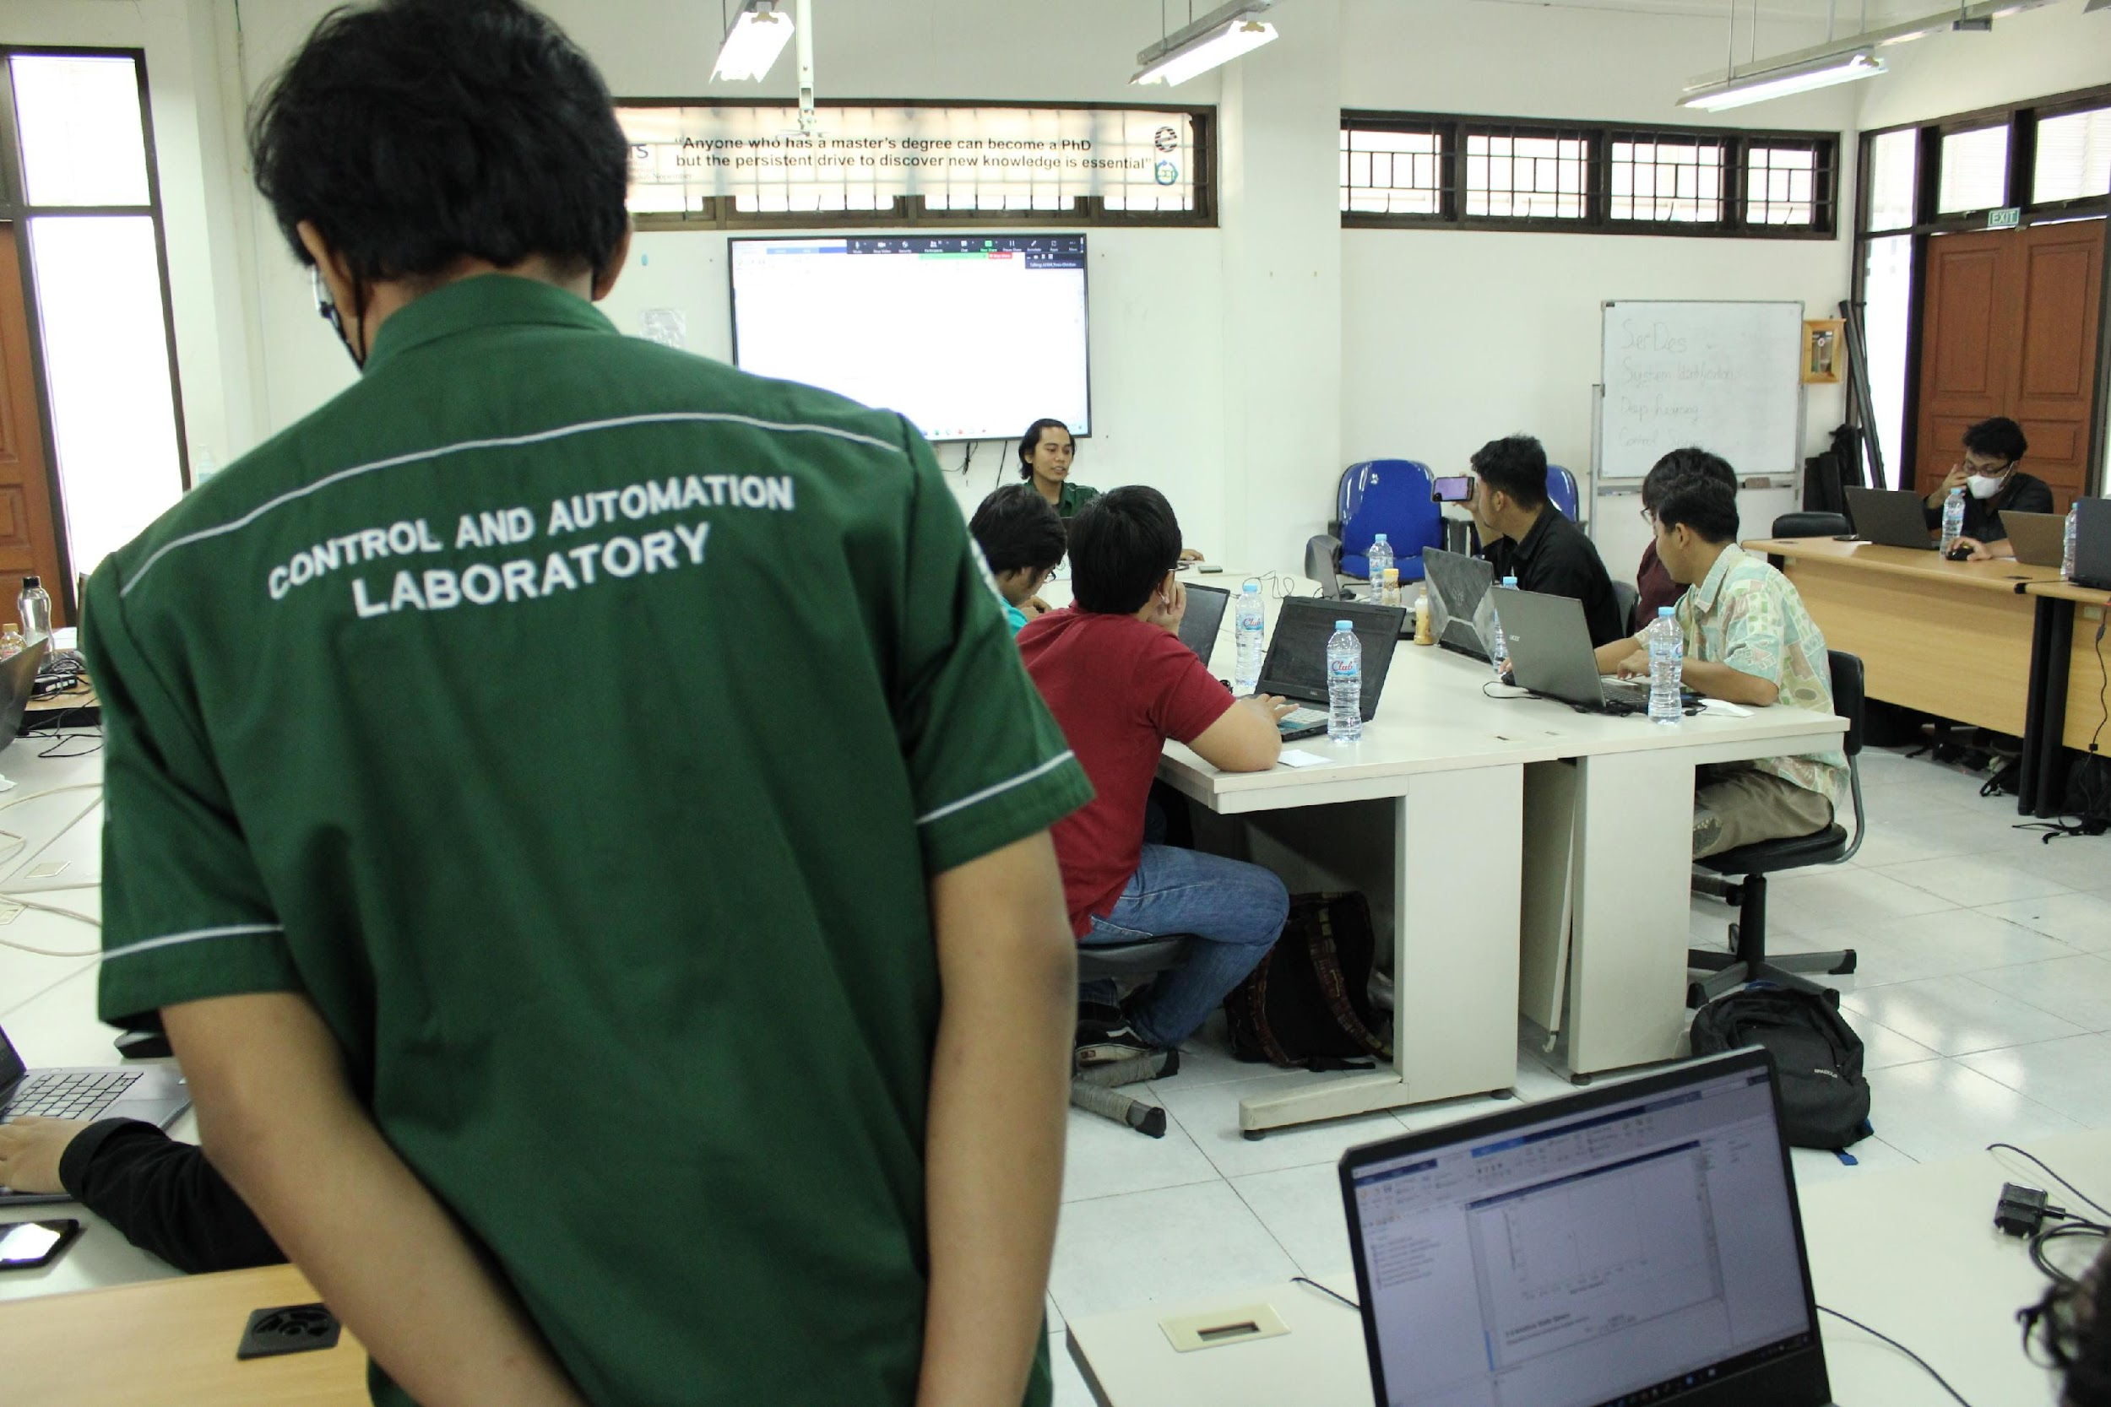
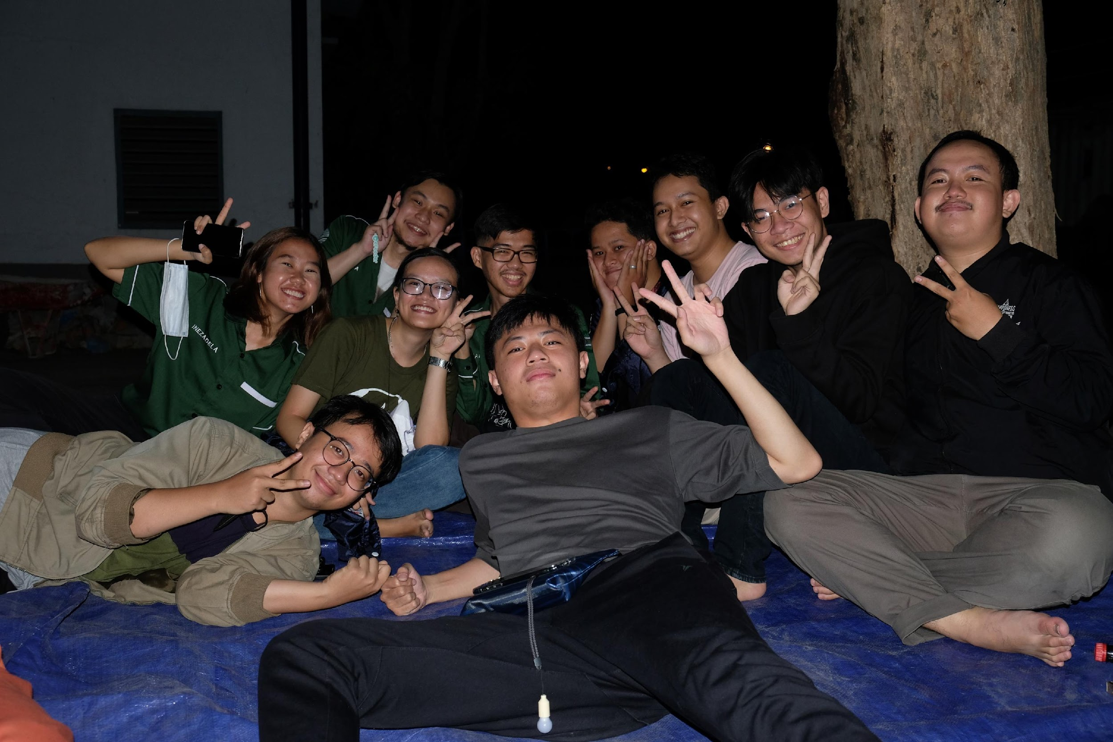
OUR ACTIVITIES
Notes:
The main activities :
Scientific Discussion Forum
Practicum
Training and Webinar
Gathering

Slide 10
PCT – 100 FEEDBACK and BYTRONIC module
Motor Control FEEDBACK module
Programmable Logic Controller (PLC) of various brands (Siemens, LG, Omron, Mitsubishi, dll.)
2 Units of pneumatic control CHUNGPA module
Hydraulic Control CHUNGPA module
Conveyor Industrial Automation Simulation module
DCS Yokogawa
OUR
FACILITIES
& TOOLS
24 hours access of laboratory and 3 AC units in every room
Books and other Control System references
Office Stationary
75” TV
Drinking water and dispenser

Slide 11
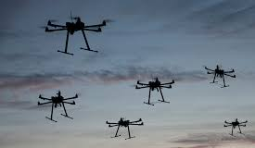
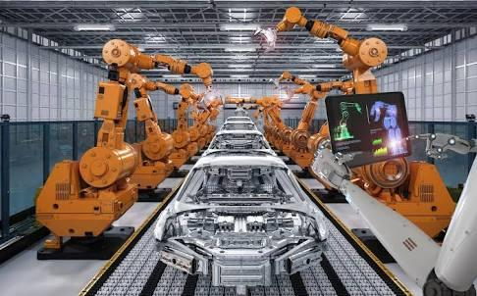
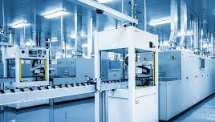
MAIN RESEARCH TOPICS
ROBOTIC
CONTROL
MECHATRONICS &
MACHINE TOOL
FOR INDUSTRIAL AUTOMATION
INDUSTRIAL &
PROCESS CONTROL
Formation Control
Trajectory Tracking and Object Avoidance
Advanced Control Engineering
Computational Intelligent

Slide 12
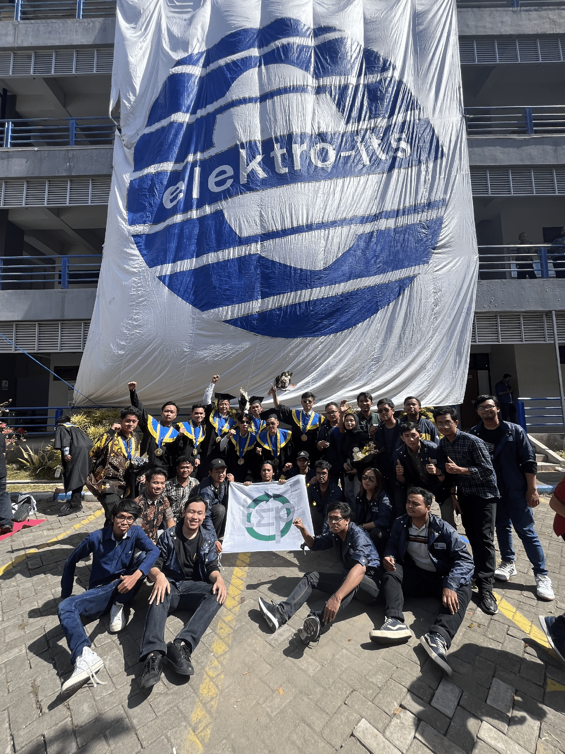
THANK YOU
TSP Bersatu, Elektro ITS Maju!

